Slide 5
“He calls them all by name…”
Isaiah 40:26
How big is God? How big and wide His vast domain?
To try to tell these lips can only start
He’s big enough to rule His mighty universe
Yet small enough to live within my heart.
Carl Stuart Hamblin

Slide 6
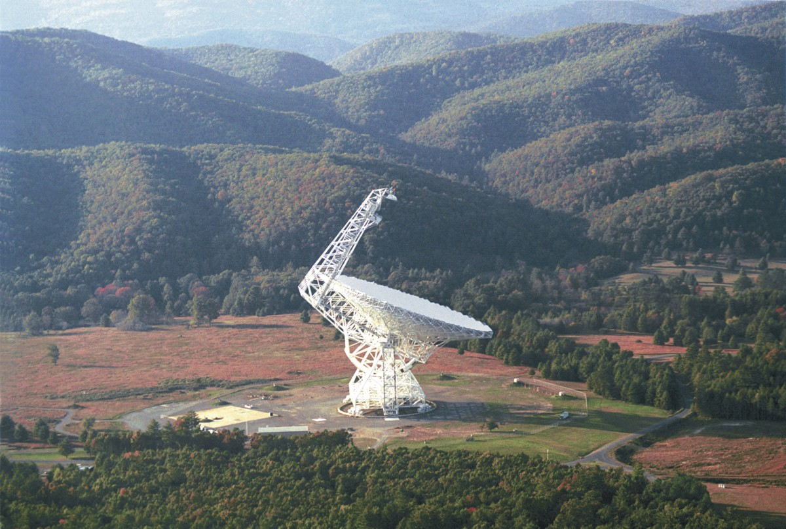
Green Bank, West Virginia
“The quietest town in America”

Slide 7
“The Music of the Spheres”
Give ear and come to me; listen, that you may live. I will make an everlasting covenant with you…
Isaiah 55:3 (NIV)

Slide 10
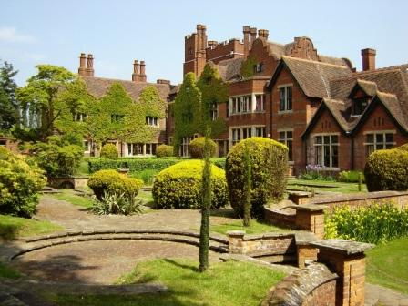
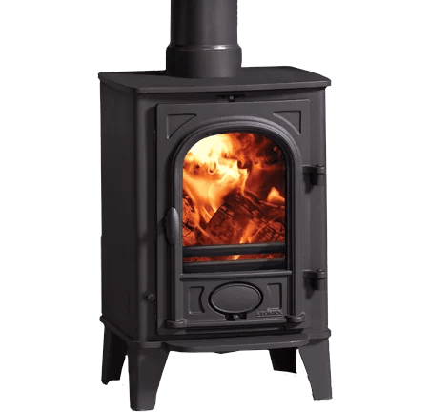

Slide 11
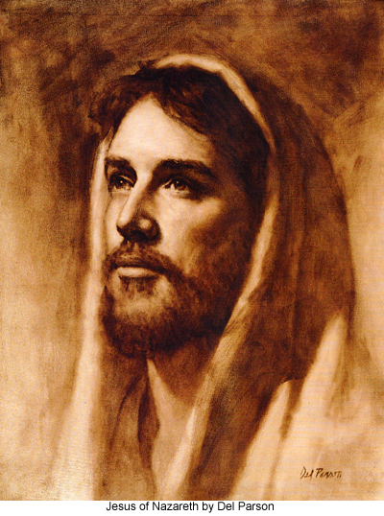

Slide 13
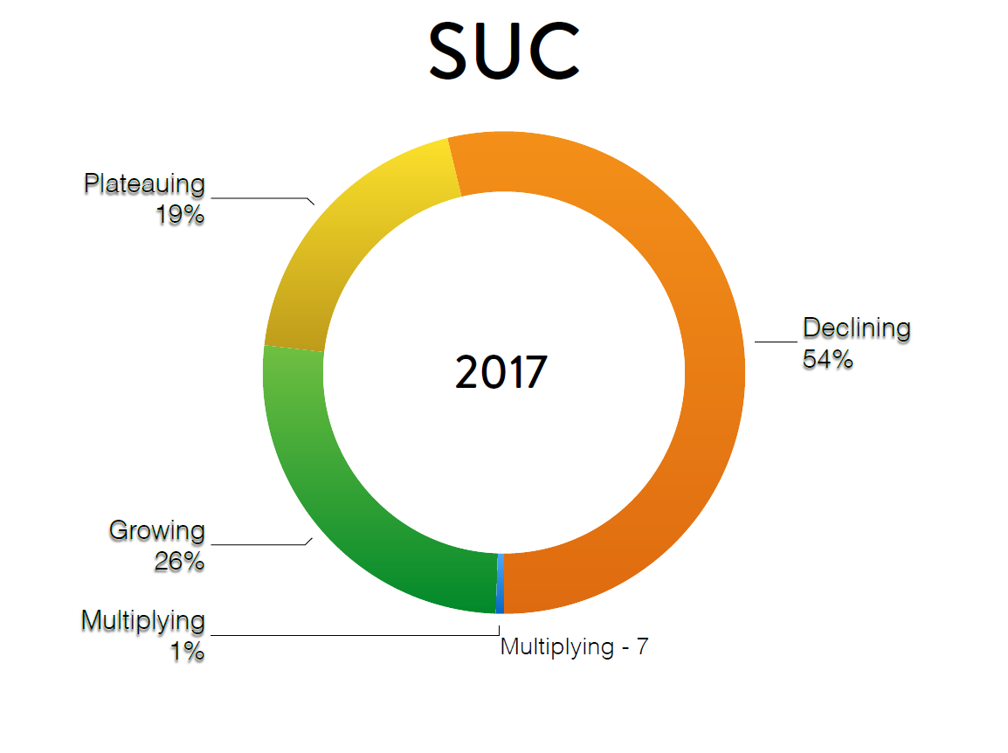
2019
Discipleship helps to grow faithful followers of Christ, and, it is absolutely necessary if we seek to move from the vast majority of Adventist churches in North America that are either declining or plateaued to churches that a vibrantly growing and multiplying.

Slide 14
Carolina Conference of
Seventh-day Adventists
Pre-Pandemic Report

Slide 15
Set your mind on things above, not on things on the earth.
Colossians 3:2 NKJV

Slide 16
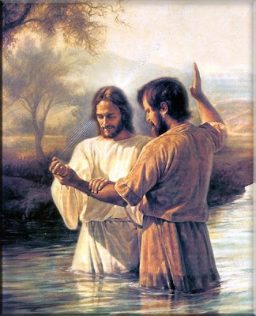
1000+ Souls
for Christ in Carolina 2022

Slide 17
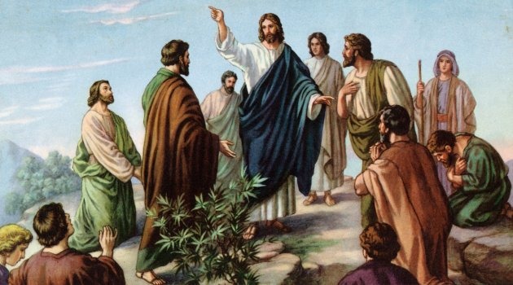

Slide 18
1. To Every Carolina Conference Church, Company or Group

Slide 19
2. To Every Executive Committee Member to be reviewed at every Executive Committee Meeting

Slide 20
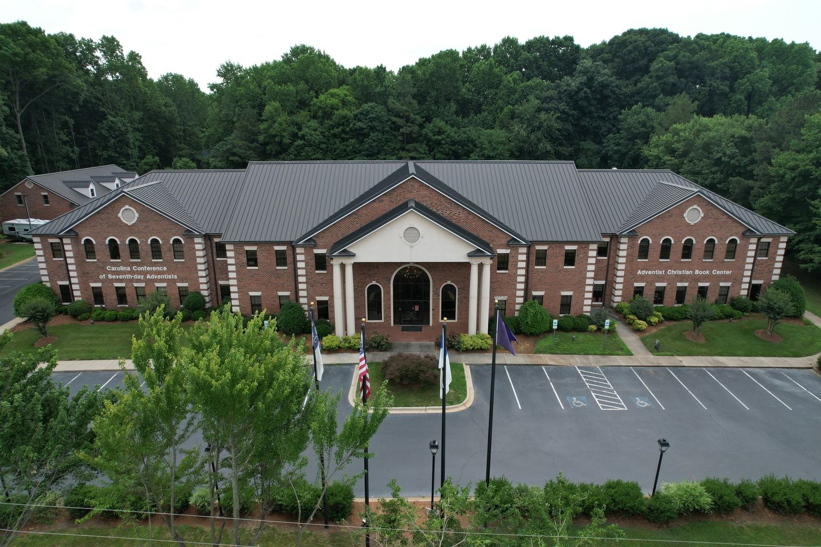
3. To Every Carolina Conference office worker to be reviewed for staff worship every Monday morning

Slide 21
4. To Every Carolina Conference Pastor

Slide 22
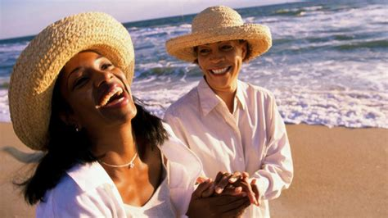
# 5

Slide 23
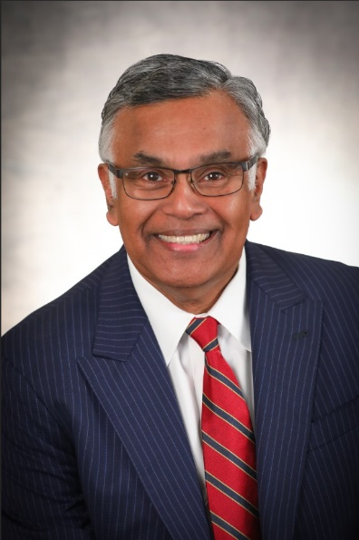
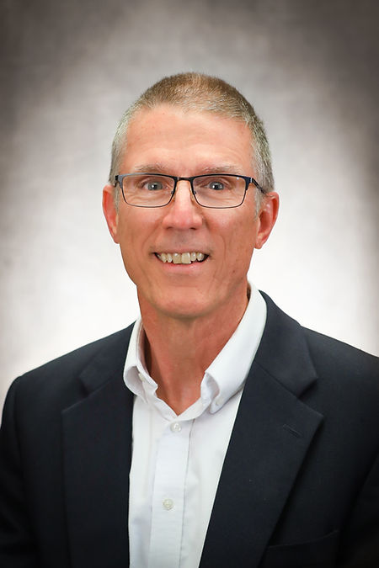
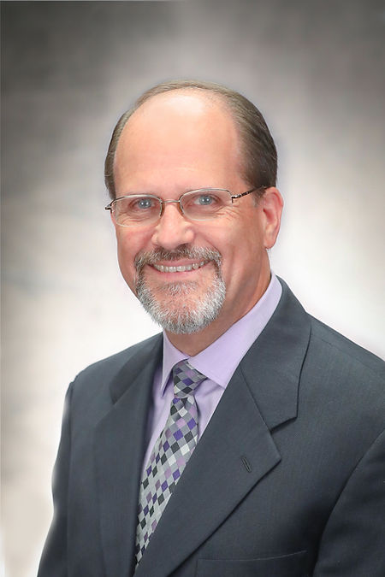
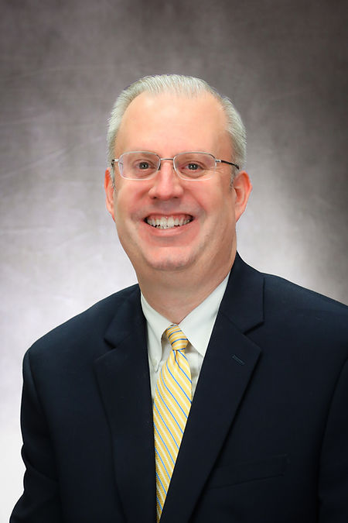
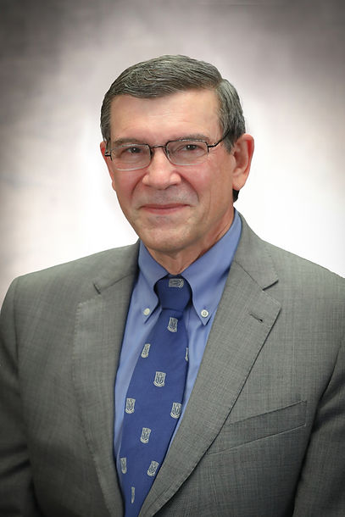
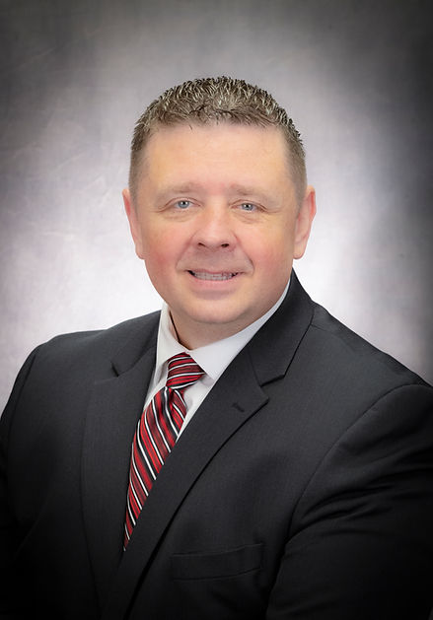
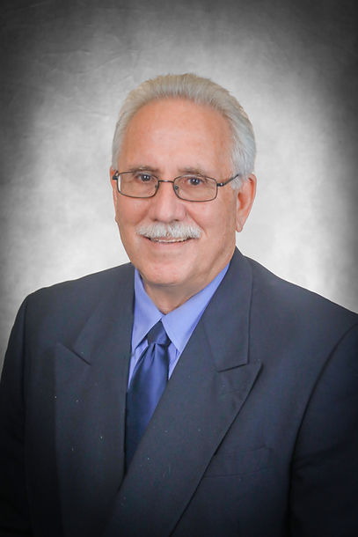
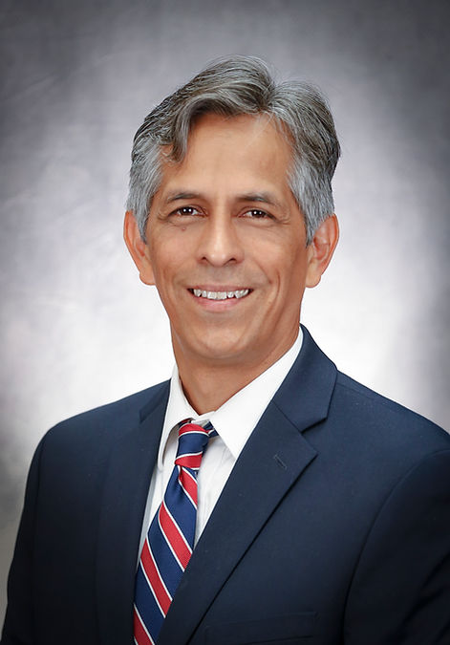
The Joint Council Retreat
January 27, 2023

Slide 24
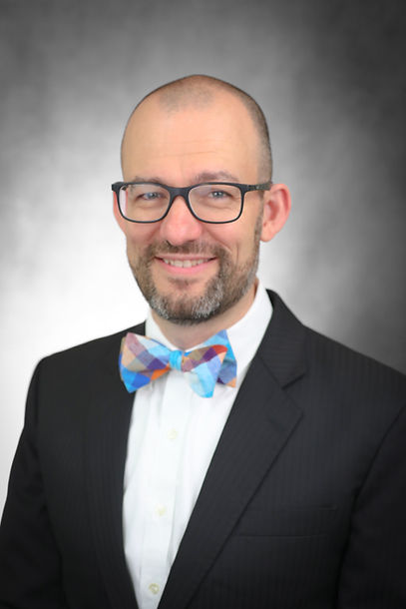
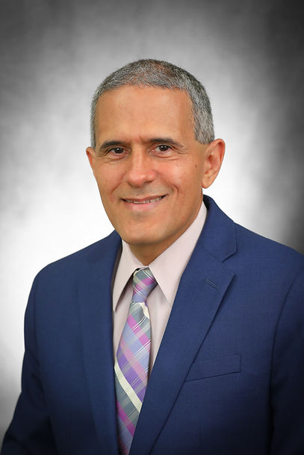
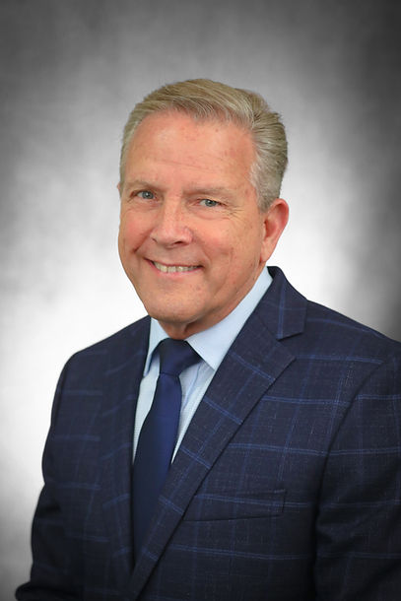
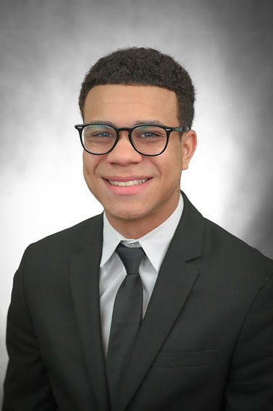
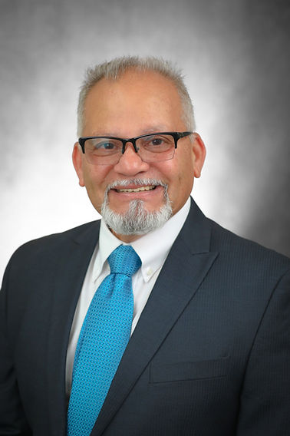
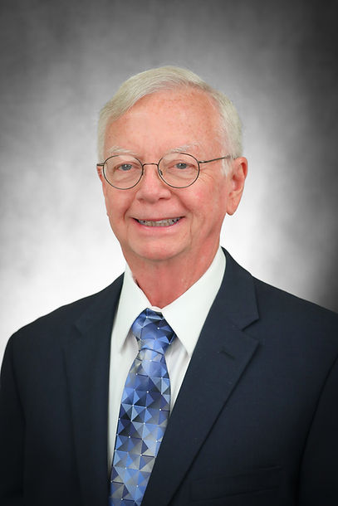
Development of A Church Health Assessment Instrument for Carolina Churches
Ryan Ashlock
Chairman
Julio Flores
Ralph Henderson
Bryan Arvelo
Tony LaPorte
Bob Grant

Slide 25
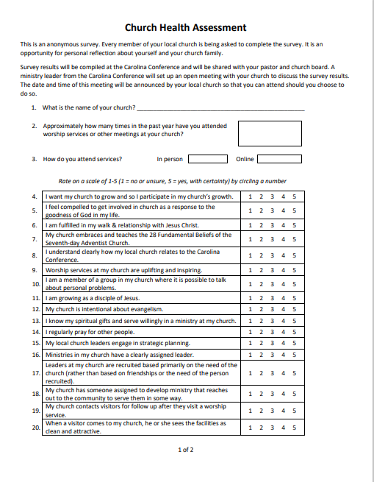
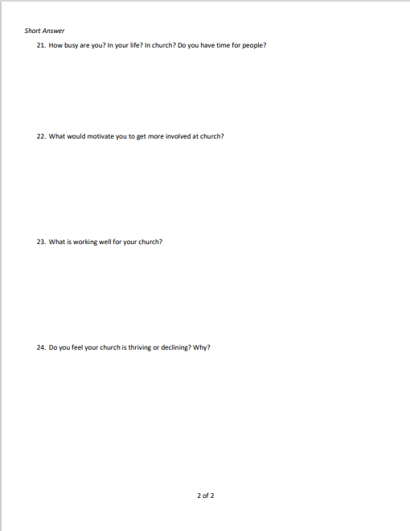

Slide 26
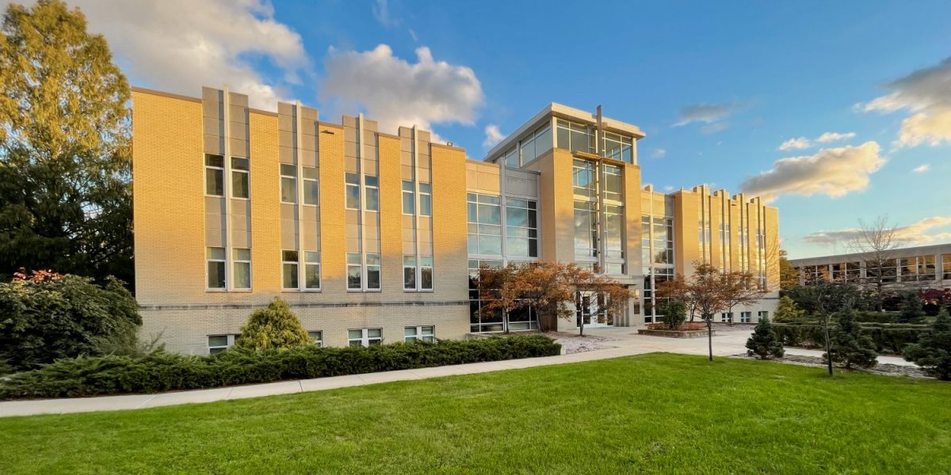
The Seventh-day Adventist Theological Seminary at Andrews University has established the Andrews Center for Community Change (ACCC). The mission of the ACCC is to help pastors in the U.S. and Canada to engage their churches with their communities.

Slide 27
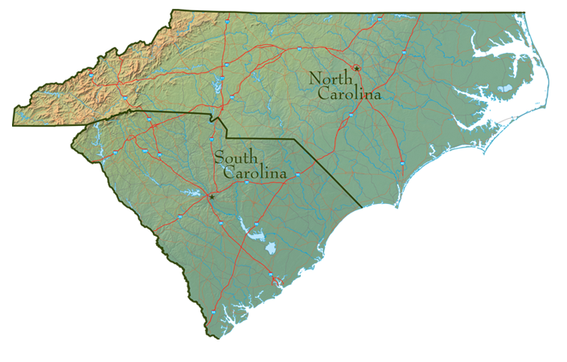

Slide 28
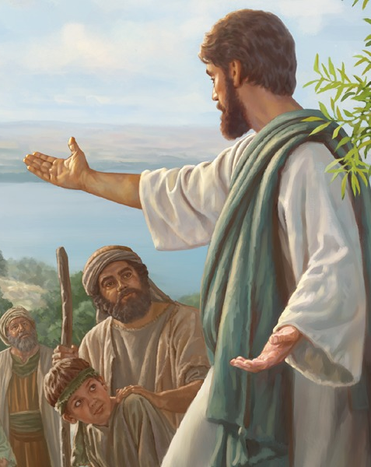

Slide 29
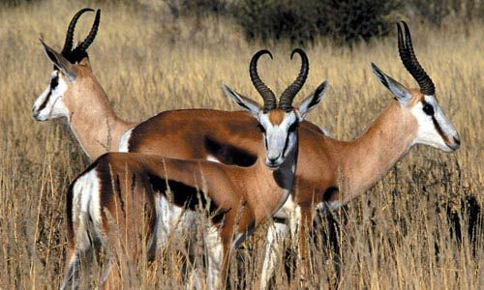

Slide 30
Let us think of ways to motivate one another to acts of love and good works. ²⁵ And let us not neglect our meeting together, as some people do, but encourage one another, especially now that the day of his return is drawing near.
Hebrews 10:24-25 (NLT)

Slide 31
“…we can comfort those in any trouble with the comfort we ourselves receive from God.”
II Corinthians 1:4 (NIV)

Slide 33
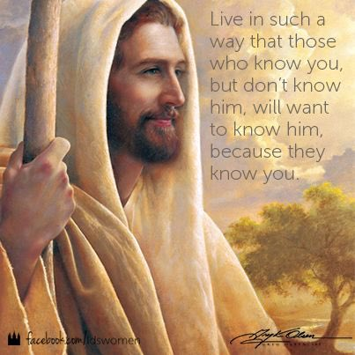
TO BE LIKE JESUS

Slide 34
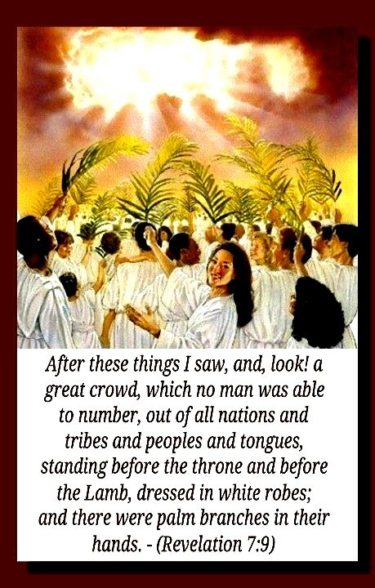
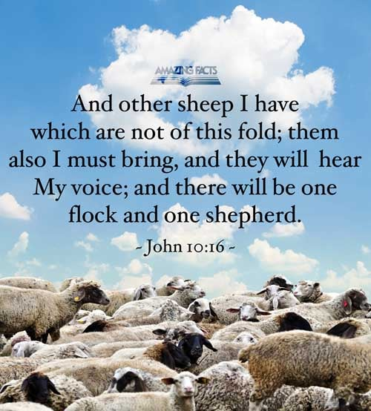

Slide 35
Thank you and
May God bless each of you!

